Slide 1

AVL TREE
Hamza Rasheed

Slide 2
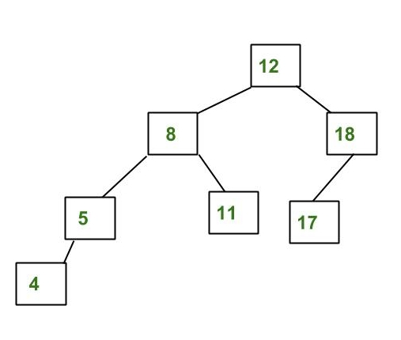
What is an AVL Tree?
An AVL tree is a type of binary search tree. Named after it's inventors Adelson, Velskii, and Landis, AVL trees have the property of dynamic self-balancing in addition to all the other properties exhibited by binary search trees.

Slide 3
AVL Tree
Each tree has a root node (at the top)
The root node has zero, one, or two child nodes
Each child node has zero, one, or two child nodes
Each node has up to two children
For each node, its left descendants are less than the current node, which is less than the right descendants
The difference between the height of right and left sub-trees cannot be more than one. This difference is called the balance factor.

Slide 4
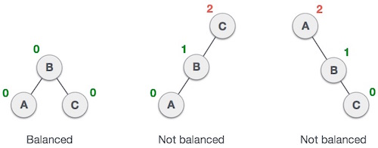
Balance Factor
Balance factor of a node in an AVL tree is the difference between the height of the left subtree and that of the right subtree of that node.
Balance Factor = (Height of Left Subtree - Height of Right Subtree)
The self balancing property of an AVL tree is maintained by the balance factor. The value of balance factor should always be -1, 0 or +1.

Slide 5
Insertion in AVL Tree:
Insertion in an AVL tree is similar to insertion in a binary search tree. But after inserting and element, you need to fix the AVL properties using left or right rotations:
If there is an imbalance in the left child's right sub-tree, perform a left-right rotation
If there is an imbalance in the left child's left sub-tree, perform a right rotation
If there is an imbalance in the right child's right sub-tree, perform a left rotation
If there is an imbalance in the right child's left sub-tree, perform a right-left rotation

Slide 6
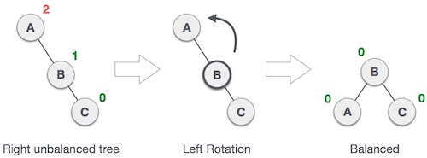
Left Rotation:
If a tree becomes unbalanced, when a node is inserted into the right subtree of the right subtree, then we perform a single left rotation.
Node A has become unbalanced as a node is inserted in the right subtree of A's right subtree. We perform the left rotation by making A the left-subtree of B.

Slide 7
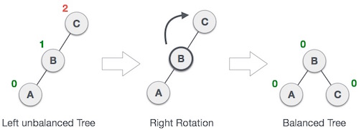
Right Rotation:
AVL tree may become unbalanced, if a node is inserted in the left subtree of the left subtree. The tree then needs a right rotation.
Node C has become unbalanced as a node is inserted in the Left subtree of C's Left subtree. We perform the right rotation by making C the right-subtree of B.

Slide 8
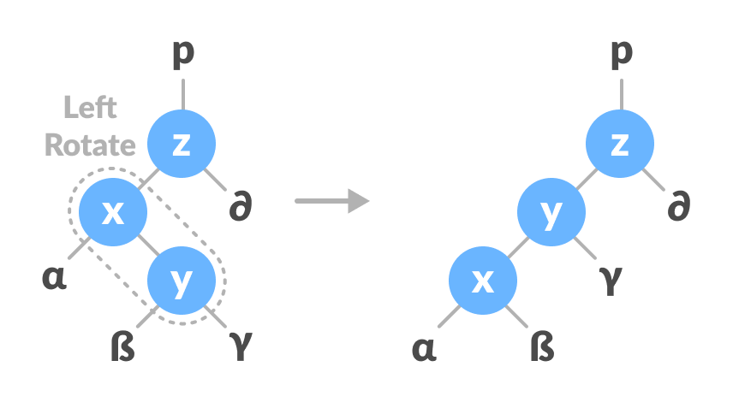
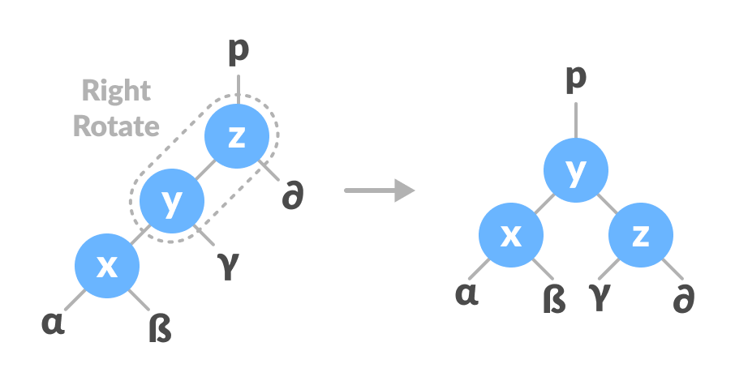
Left-Right Rotation:
In left-right rotation, the arrangements are first shifted to the left and then to the right.

Slide 9
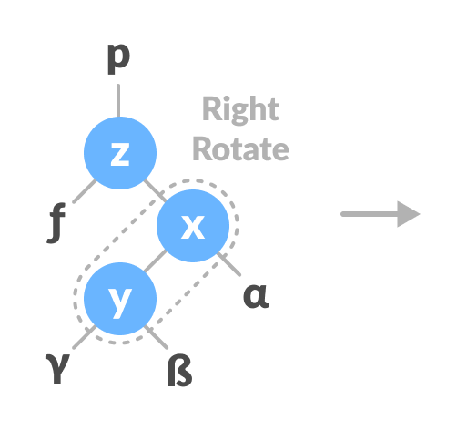
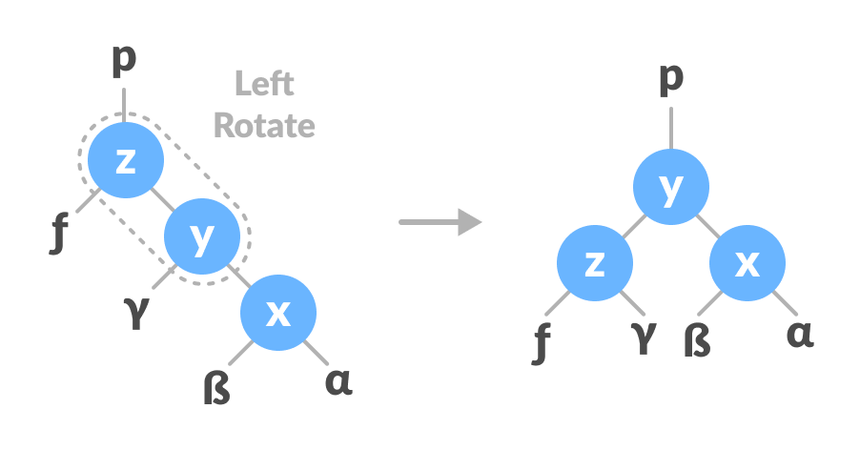
Right-Left Rotation:
In right-left rotation, the arrangements are first shifted to the right and then to the left.

Slide 10
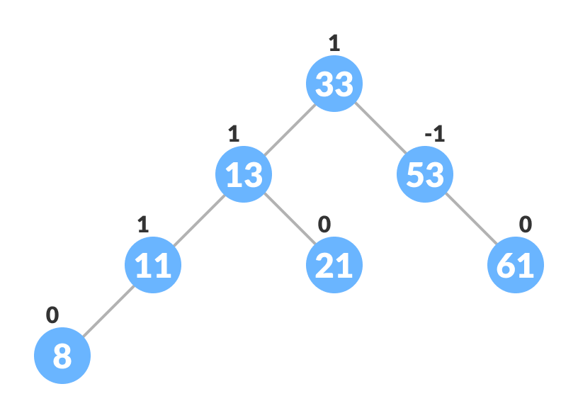

Insert a new Node:
Let node 9 to be inserted in tree.

Slide 11
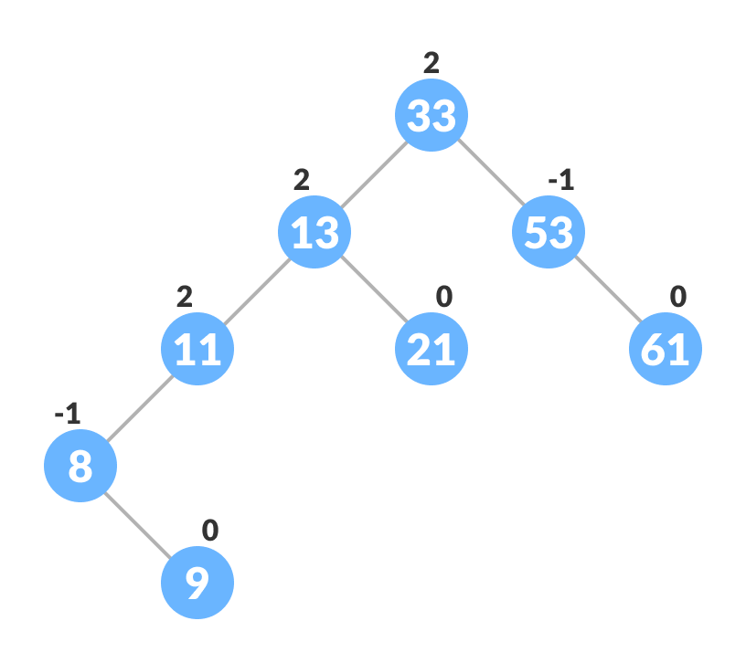
Insert a new Node:
Node 9 is inserted at left sub-tree of node 8

Slide 12
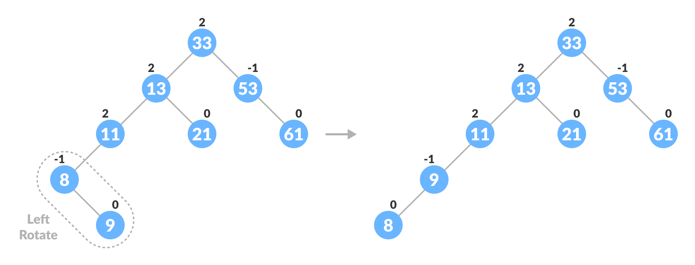
Insert a new Node:
Node 11 become unbalanced we apply Left-Right rotation .

Slide 13
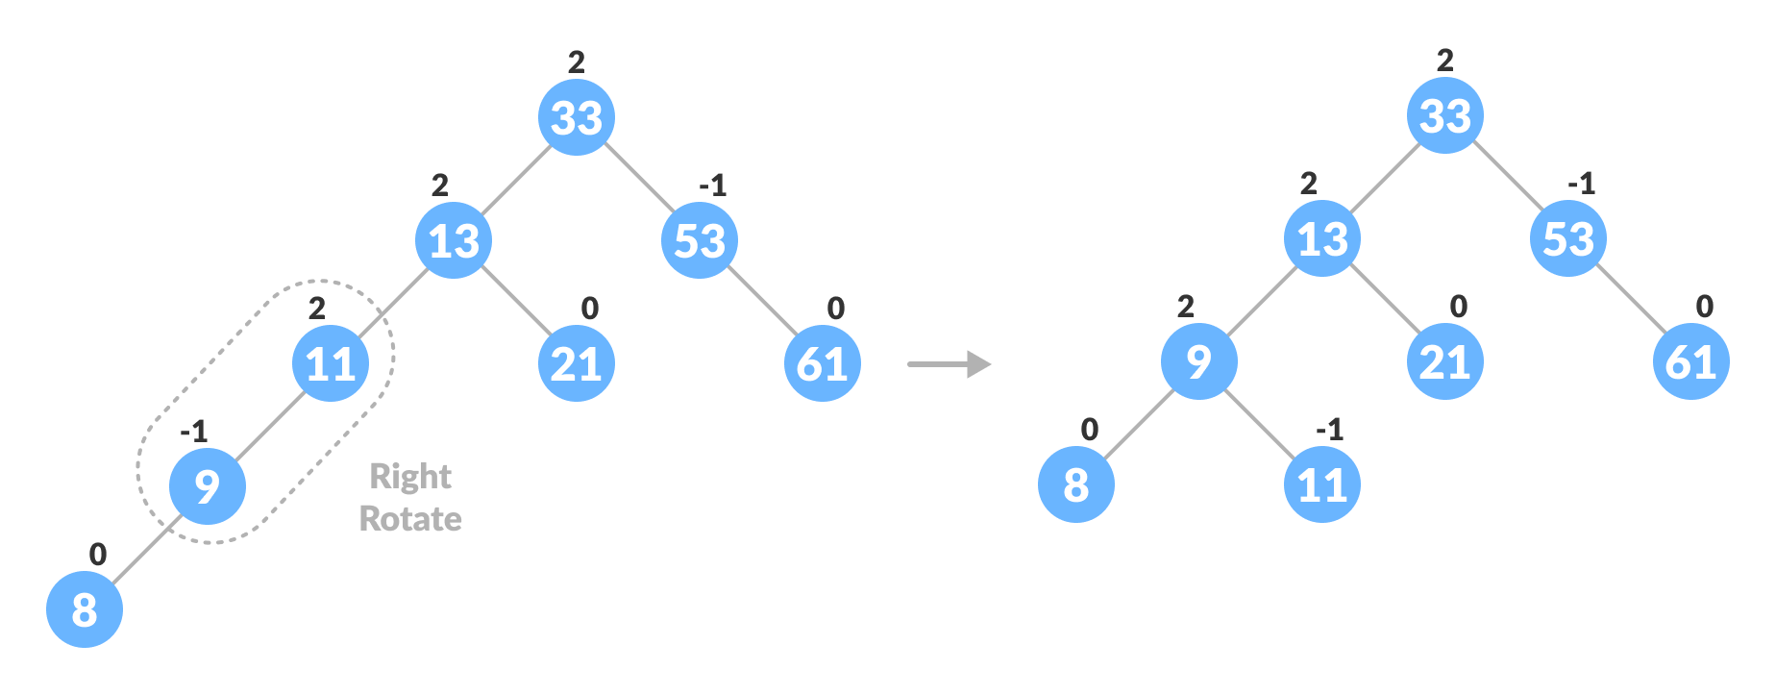
Insert a new Node:
Node 11 become unbalanced we apply Left-Right rotation .

Slide 14
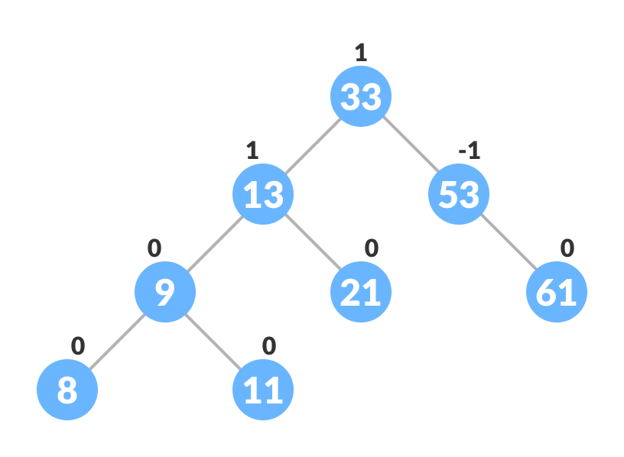
Insert a new Node:
The final tree becomes:

Slide 15
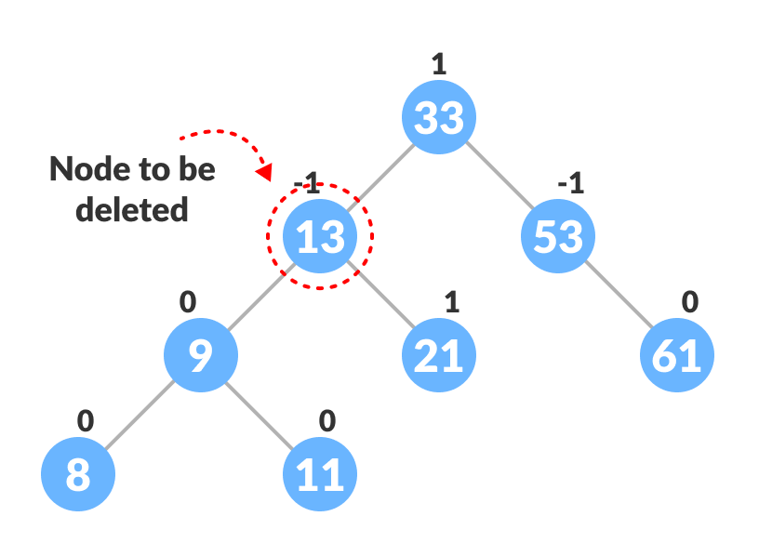
Delete a node:
After deleting a node, the balance factors of the nodes get changed. In order to rebalance the balance factor, suitable rotations are performed.

Slide 16
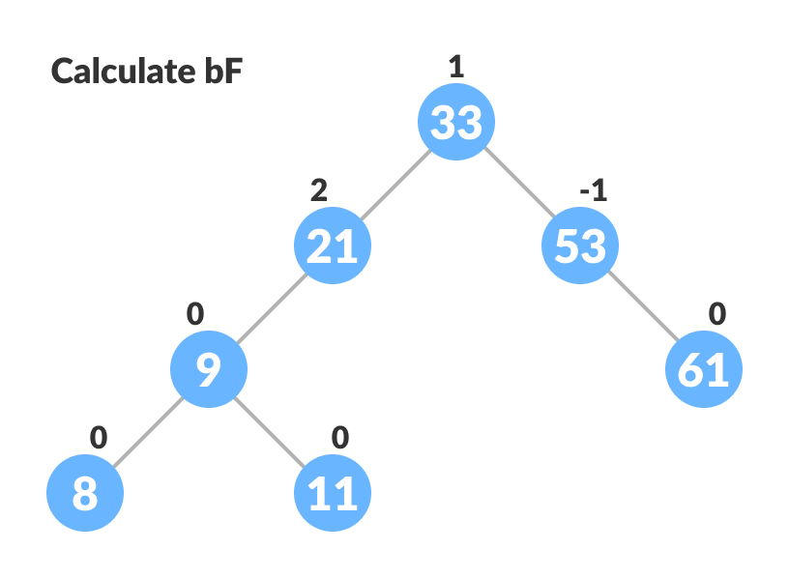
Delete a node:
After deleting a node, the balance factors of the nodes get changed. In order to rebalance the balance factor, suitable rotations are performed.

Slide 17
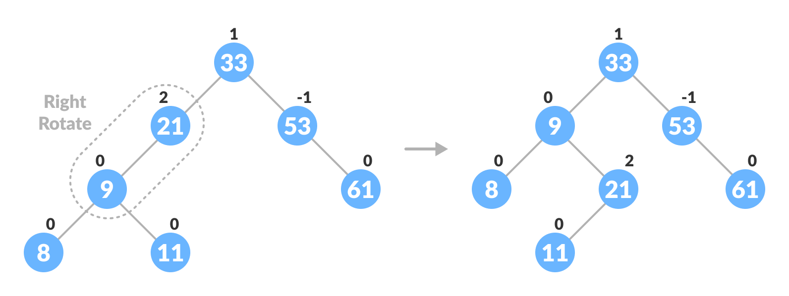
Delete a node:
Rebalance the tree if the balance factor of any of the nodes is not equal to -1, 0 or 1.

Slide 18
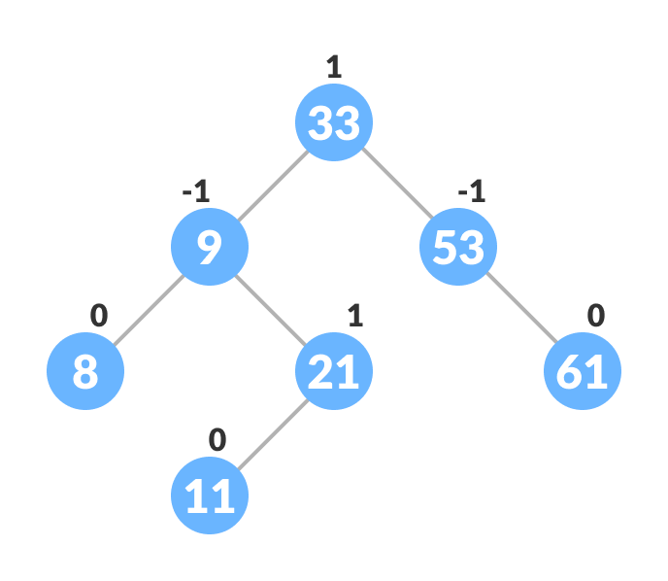
Delete a node:
The final tree is:

